Slide 1
Spring Core
Junior Training Program
Janos Biro
Notes:
ET: (exercise together, examining API, doing a coding example together)
EA: (exercise to be done individually)
Other notes: reminders for the presentator
Preparation:
Create your own repository at gitbud
Name cards
Commits to save the day (help): checkout if the presenter stuck, or copy snippets from it (do not show to pupils)
https://gitbud.epam.com/janos_biro/spring-core-training/commits/master
BUT the presentation should be dynamic, create a new gibud repo at the start of each training, commit continously and share the hascode if something went wrong (also solve the EAs)
You can always choose other ETs and EAs, but try to follow them (so that you can use your help (see above))
EAs here are examples, help does not include them
„ET” without any notes means that the code on the slide must be typed in together

Slide 2
The Big Picture
Java SE (J2SE)
http://docs.oracle.com/javase/7/docs/index.html
Component model: JavaBeans
Naming conventions
PropertyEditors
Etc., things we usually do not use
Java EE (J2EE)
http://www.oracle.com/technetwork/java/javaee/overview/index.html
Collection of specifications (NOT a software)
„Application servers” as implementations
Complex component/development model (Web and Business components)
Container concept, sophisticated architecture patterns
Notes:
ET:
- Eclipse Java project
- write a sample JavaBean

Slide 3
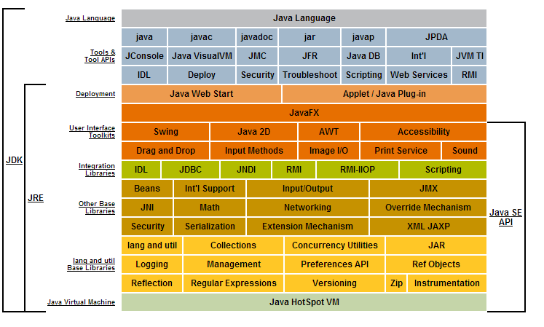
Java SE big picture

Slide 4
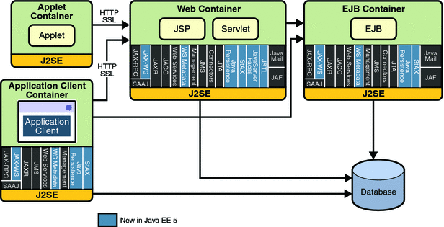
Java EE big picture
Notes:
Main problem:
EJB, programming model
Don’t be unfair: great improvements have been made in Java EE
Servlet and JSP were valid technologies all the time
Tons of great standards emerged (JMX, JPA itself, however it has been moved, it is the tendency…)
Good example: threads in a container
Do not make comparisons here…evaluate when necessary
Great stuff, with different approach: both capable middlewares
Spring advantages: follows the changes in standards more quickly, it is easy to integrate with non-standard technologies… BUT… it is more lego-like feeling
- Java EE sticks to the standard solutions very much, big brother feeling

Slide 5
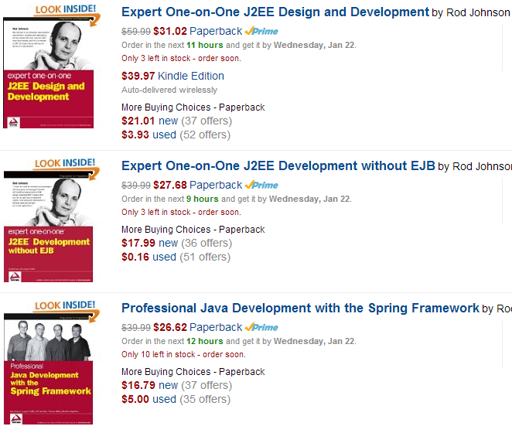
Spring
Notes:
See the progress

Slide 6
Spring promises
Lightweight, minimally invasive development
component model: POJOs(!)…let’s call them „beans”
Let you focus on solving the domain problem
Loose coupling between components
Glue: Dependency injection
Declarative programming
Aspects, conventions
Boilerplate reduction
Aspects, templates
All-in-one solution for client/server applications
Notes:
Non-invasive: should not be forced to introduce framework-specific classes and interfaces into your business/domain model

Slide 7
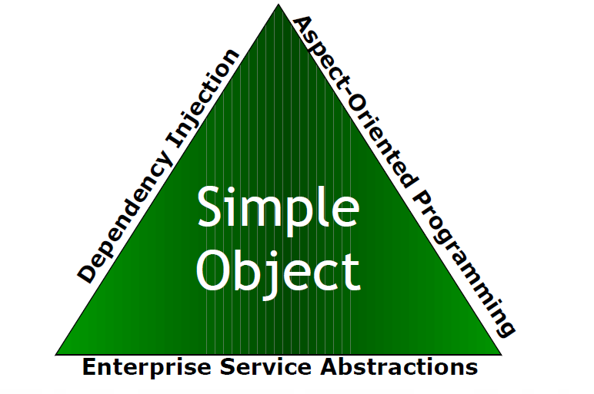
Spring triangle
POJOs + configuration
Proxies add additional behavior to your beans
Easy-to-use solutions for common enterprise needs
Notes:
We’ll mostly discuss DI.
Enterprise != big company but instead „professional, serious”

Slide 8
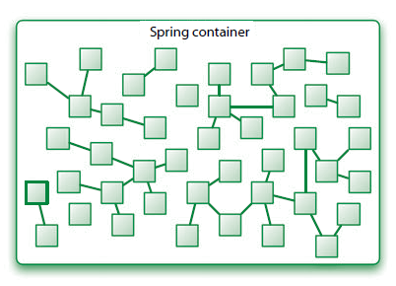
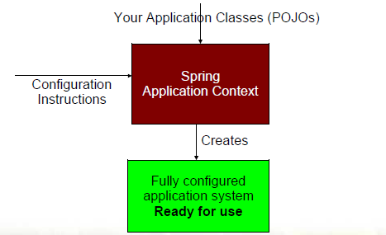
Spring Core in its very core…
The „ApplicationContext” is the gatekeeper to this container…
as long as you fetch your beans from it you’ll get all its services.
BUT you can still instantiate your classes using the old way using „new”.
Nothing holds you back, but you’ll loose everything the Context provides!
Notes:
Container concept:
Call the container (old J2EE)
New container concept
Still, the container is our big brother

Slide 9
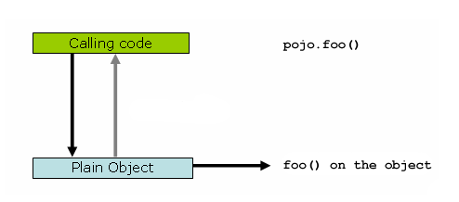
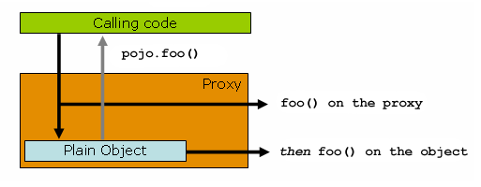
Proxy concept

Slide 10
Spring enterprise abstractions
Enterprise applications do not work in isolation
They require enterprise services and resources like
Database Connection Pool
Database Transactions
Security
Messaging (JMS)
Remote Access
Caching
etc.
Notes:
Another training

Slide 11
Preparation
Install JDK 7
http://www.oracle.com/technetwork/java/javase/downloads/jdk7-downloads-1880260.html
JAVA_HOME, PATH, never use „Program Files”
Install STS 3.4 RELEASE
http://download.springsource.com/release/STS/3.4.0/dist/e4.3/spring-tool-suite-3.4.0.RELEASE-e4.3.1-win32-x86_64.zip
Install GIT 1.8.X
http://git-scm.com/download/win
Create your own GITBUD repo
https://gitbud.epam.com
Notes:
Install from ZIP!

Slide 12
If you are lost… a hashcode can save the day!
The Beans of The Old Republic
https://gitbud.epam.com/janos_biro/spring-core-training-[X]/commits/master
git clone git@gitbud.epam.com:janos_biro/spring-core-training-[X].git
git checkout [hashcode]
Notes:
ET: Create: Eclipse/Maven project/Quick start archetype, junit removed
4de66641e Maven Hello World

Slide 13
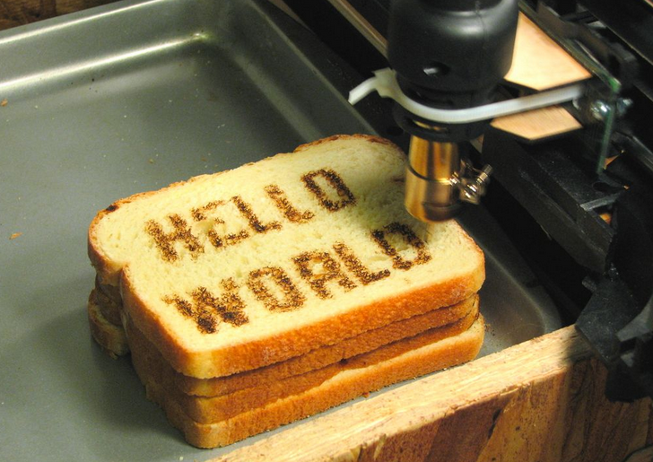
Starter application
Notes:
ET: Create: Eclipse/Maven project/Quick start archetype, junit removed
4de66641e Maven Hello World

Slide 14
POJO – Plain Old Java Object
public class Jedi {
private final LightSabre lightsabre;
public Jedi() {
lightsabre = new LightSabre("Slicer", 10);
}
public String fight() {
return lightsabre.hit();
}
}
Notes:
Problems:
Non-clear dependencies
hard to unit test

Slide 15
POJO
public static void main(final String[] args) {
Jedi jedi = new Jedi();
System.out.println(jedi.fight());
}
Notes:
Problems:
Non-clear dependencies
hard to unit test
1ee61d8d9 first domain
ET: create domain models, Jedi, Lightsabre (no need to create all the domain model in the help)

Slide 16
Dependency injection
„Do not call us, we call you!”
Objects aren’t expected to create or obtain their dependencies
Objects express what dependencies they need in a descriptive manner
Objects are given their dependencies at creation time by someone else who coordinates each object in the system

Slide 17
Dependency injection benefits
Your object is handed what it needs to work
Frees your object from the burden of resolving its dependencies
Simplifies your code, improves code reusability
Promotes programming to interfaces
Conceals the implementation details of each dependency
Improves testability
Dependencies can be easily stubbed out for unit testing
Allows for centralized control over object lifecycle
Opens the door for new possibilities

Slide 18
Dependency injection
public class Jedi {
private final LightSabre lightsabre;
public Jedi(final LightSabre lightsabre) {
this.lightsabre = lightsabre;
}
public String fight() {
return lightsabre.hit();
}
}

Slide 19
Dependency injection – „manually”
public static void main(final String[] args) {
LightSabre lightSabre = new LightSabre("Slicer", 10);
Jedi jedi = new Jedi(lightSabre);
System.out.println(jedi.fight());
}
„ZzzzzzzZzzzzzz”
Notes:
ET
It is not real DI of course
DI: constructors and setters
6972db8b1 DI

Slide 20
Dependency injection – using Spring
public class App {
public static void main(final String[] args) {
BeanFactory factory = new XmlBeanFactory(new ClassPathResource("beans.xml"));
Jedi jedi = factory.getBean("OdanUrr", Jedi.class);
System.out.println(jedi.fight());
}
}
„ZzzzzzzZzzzzzz”
Notes:
ET
- Add Spring dependency (http://projects.spring.io/spring-framework/)
Add Spring nature (Update Maven…)
Create xml via Eclipse
IoC container === BeanFactory

Slide 21
Dependency injection – using Spring
<?xml version="1.0" encoding="UTF-8"?>
<beans
xmlns="http://www.springframework.org/schema/beans"
xmlns:xsi="http://www.w3.org/2001/XMLSchema-instance"
xsi:schemaLocation="http://www.springframework.org/schema/beans http://www.springframework.org/schema/beans/spring-beans-3.2.xsd">
<bean id="odanUrr" class="com.epam.botor.domain.Jedi">
<constructor-arg ref="lightsabre" />
</bean>
<bean id="lightSabre" class="com.epam.botor.domain.LightSabre">
<constructor-arg value="Slicer" />
<constructor-arg value="10" />
</bean>
</beans>
Notes:
EA: own Jedi or Lightabre, no Sith here ☺
XML namespaces, Spring namespaces
Naming convention
Basic wiring rules
http://docs.spring.io/spring/docs/3.2.6.RELEASE/spring-framework-reference/html/beans.html
6745357b1 DI with BeanFactory

Slide 22
Spring namespaces
<?xml version="1.0" encoding="UTF-8"?>
<beans
xmlns="http://www.springframework.org/schema/beans"
xmlns:xsi="http://www.w3.org/2001/XMLSchema-instance"
xsi:schemaLocation="http://www.springframework.org/schema/beans http://www.springframework.org/schema/beans/spring-beans-3.2.xsd">
Higher-level configuration languages that build on the generic <beans/> language
Simplify common configuration needs
Each language is defined by its own XML namespace you may import
You can even write your own

Slide 23
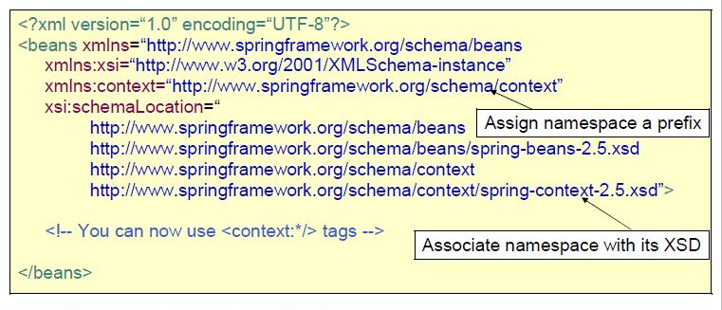
Spring namespaces

Slide 24
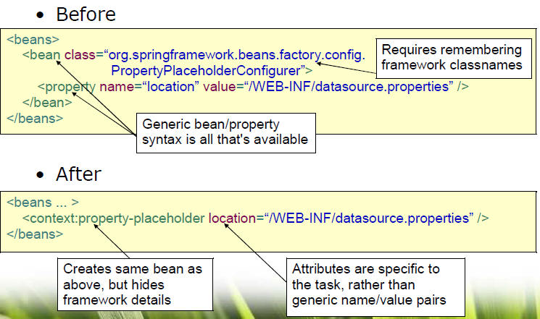
Spring namespaces

Slide 25
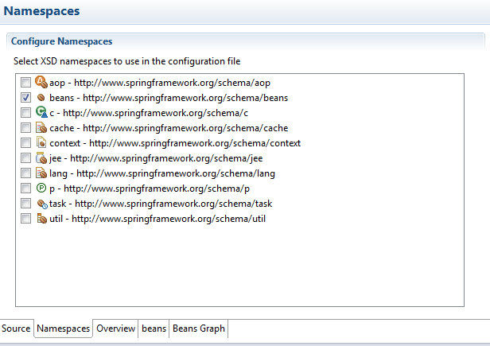
Spring namespaces
Notes:
ET

Slide 26
ApplicationContext
Feature | BeanFactory | ApplicationContext
Bean instantiation/wiring | Yes | Yes
Automatic BeanPostProcessor registration | No | Yes
Automatic BeanFactoryPostProcessor registration | No | Yes
Convenient MessageSource access (for i18n) | No | Yes
ApplicationEvent publication | No | Yes
Notes:
ET
You’ll always use ApplicationContext
http://docs.spring.io/spring/docs/3.2.6.RELEASE/spring-framework-reference/html/beans.html#beans-beanfactory
Lazy initialization: BeanFactory DOES lazy by default, while ApplicationContext is eager by default, see the log messages
Switch to application context: use context.jar (see how dependencies are managed by Maven)
7673b7f29 switch to ApplicationContext

Slide 27
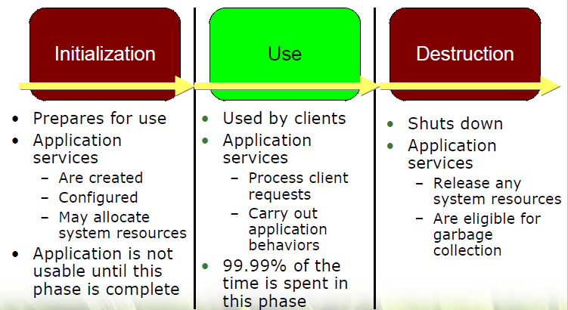
Container lifecycle
Notes:
ET: close the application context,
EA: Show shutdown hooks of Java SE, AbstractApplicationContext can register shutdown hooks… let them do it

Slide 28
Bean naming
id: XML standard, specify exactly one identifier, follows XML naming restrictions
name: any number of comma separated identifiers
you are not required to supply a name or id for a bean.
If no name or id is supplied explicitly, the container generates a unique name for that bean.
<alias name="fromName" alias="toName"/>
Notes:
Anonym: inner beans, autowiring collaborators
Alias: similiar to name=„,,,,” but sometimes it is not possible (multiple XML files)
EA: create aliases, name current ones differently and try those names

Slide 29
Composing XML
<beans>
<import resource="services.xml"/>
<import resource=„daos.xml"/>
<bean id="bean1" class="..."/>
<bean id="bean2" class="..."/>
</beans>
VS.
ApplicationContext context =
new ClassPathXmlApplicationContext(new String[] {"services.xml", "daos.xml"});
Notes:
Path relative to the importer
XML file order does not matter
EA: try both solutions

Slide 30
Bean lifecycle
Do not confuse bean definitions, bean (instances), and Java classes!
Java class: OK
Bean (instance): instance of a Java class created by the container,
hence „living” in the container
Bean definition: template/recipe for how to create/manage beans
defined by
<bean /> tag in XML
@Component annotation
@Bean (JavaConfig)
meta-data for the container
class
name
constructor arguments / properties (a.k.a. dependencies or collaborators)
how to manage the lifecycle of the beans

Slide 31
Bean lifecycle - scopes
Singleton (default! : it is why it is easy to be confused around bean definitions and bean instances)
Prototype
Session, Request, Global session: web related (see in Spring MVC training)
Custom: out-of-scope, advanced

Slide 32
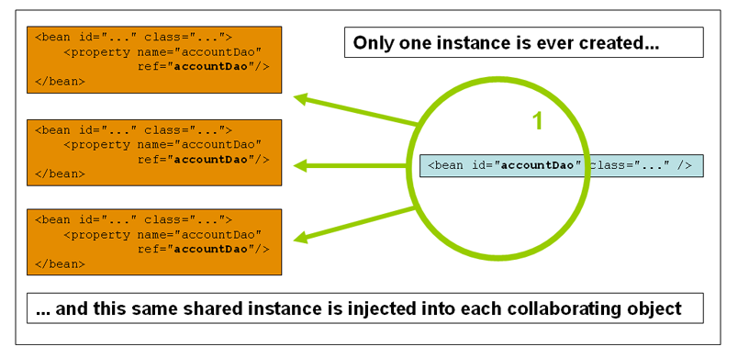
Bean lifecycle – scopes - singleton
Notes:
6b5af0a03 Scopes – singleton
Important: there is no way to add information (e.g. „name” to a prototype bean at time of instantiation) to the bean definition
Solution: create a factory (not now!)
ET:
Show same Lightsabre, different Lightsabre (with identityHashCode)
Singleton pattern in Spring
Show Sring Beans in Eclipse, Bean editor

Slide 33
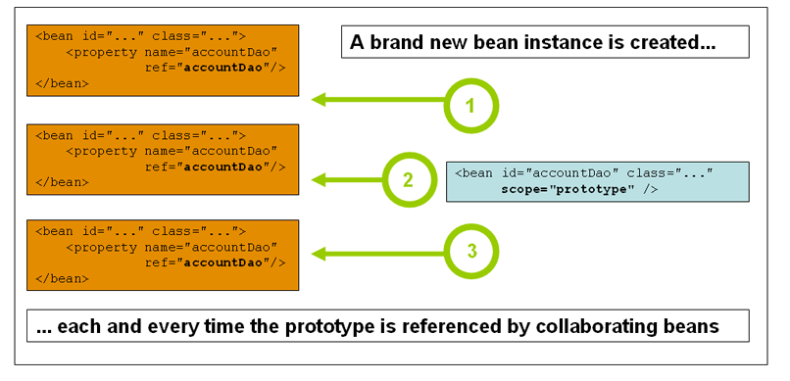
Bean lifecycle – scopes - prototype
Notes:
61fae8c3e Scope – prototype
ET:
Show same Lightsabre, different Lightsabre (with identityHashCode)
Singleton pattern in Spring
Show Sring Beans in Eclipse, Bean editor
EA:
Create several Jedi, make them friends, friends may have the same lightsabres (sharedLightSabre or someting like that)

Slide 34
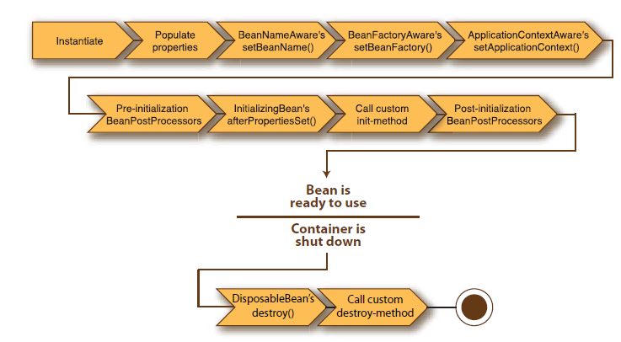
Bean lifecycle – the full picture
Notes:
It is what the container knows, nothing more!

Slide 35
No magic!
„This [feature goes here like @Transactional] is
Spring magic, some low level hacking, go ahead”
No! You must understand (at least have a clue) how Spring features you are dealing with actually work.
All Spring features
are just Beans leveraging the bean life cycle
AND/OR are using container extension points
BeanPostProcessor
BeanFactoryPostProcessor
FactoryBean (remember, NOT BeanFactory!)
Notes:
Not always seems true in case of Java EE
It means that it as all what the container (ApplicationContext) provides, nothing else!

Slide 36
Bean lifecycle
All beans are fully initialized before they are used
Beans are always created in the right order
Based on their dependencies
Each bean is bound to a unique id
The id reflects the service the bean provides to clients

Slide 37
Bean lifecycle - instantiate
Constructor (!=new operator but the constructor is called)
reflection (see java.lang.reflect)
proof: works even with private constructor
Static factory method
Instance factory method
Notes:
711b08dba Instantite 3 ways
ET:
see the reflection API
quick and bad example let the Jedi create lightsabres (delete code after)
EA:
- Create a LightSabre static factory and factory bean (help has an ugly example), we may delete this code as well, do not use this kind of factories at all

Slide 38
Bean lifecycle - callbacks
InitializingBean
afterPropertiesSet()
DisposableBean
destroy()
No destroy method is called on beans whose lifecycles are "smaller" than the lifecycle of the overall application context (e.g. prototype scope, or @Configurable)… What do you think, why?
Notes:
Explanation…. Otherwise the the container should have references to each of them… NOOO way
fe6b59bb5 Lifecycle callbacks, interfaces
ET: add these methods to the Jedi

Slide 39
Bean lifecycle – callbacks (in XML)
init-method
afterPropertiesSet() - any method you want
destroy-method
destroy() - any method you want
Notes:
ET: show the attributes
EA: let them find the defaults
Defaults in „beans”

Slide 40
Bean lifecycle – callbacks (with annotations)
@PostConstruct
afterPropertiesSet() – any method you want
@PreDestroy
destroy() - any method you want
Wait! Is it magic?
<bean class="org.springframework.context.annotation.CommonAnnotationBeanPostProcessor"/>
Notes:
Explain what an annotation is
ET: see the code of an annotation
EA: let them specify more, and explore what happens
If you specify the same method using different ways: called once
If you specify different methods using different ways: called multiple times
There is no such thing in the lifecycle, so… EXTENSION POINT
<bean class="org.springframework.context.annotation.CommonAnnotationBeanPostProcessor"/>
967c53f8f Lifecycle callbacks - annotation

Slide 41
Bean lifecycle – BeanPostProcessor
Manipulates bean (instances)
They are beans themselves (of course)
Executed before and after EVERY bean initialization (do not confuse with instantiation)
Typically
Wrap a bean, decorating with new behavior…
based on annotations or other properties of the newborn bean

Slide 42
Bean lifecycle – BeanPostProcessor
public class MyBeanPostProcessor implements BeanPostProcessor {
@Override
public Object postProcessBeforeInitialization(final Object bean, final String beanName) throws BeansException {
//do with the bean anything you want
return bean;
}
@Override
public Object postProcessAfterInitialization(final Object bean, final String beanName) throws BeansException {
//do with the bean anything you want
return bean;
}
}
<bean class="com.epam.botor.SayRiseBeanPostProcessor"/>
Notes:
f91c79337 BeanPostProcessors explained
ET:
create a BBP which says Welcome for each Jedi
EA:
- Sith and common structure
- create a BBP which says Rise and Welcome Lord + name + set the Alliance for them before and after init, see which wins, the init method vs. BBP

Slide 43
Bean lifecycle – BeanPostProcessor
Commonly used BeanPostProcessors can be registered
<context:annotation-config/>

Slide 44
Bean lifecycle – demystifying namespaces
<context:annotation-config>
Eclipse: Ctrl+T (*NameSpaceHandler)
ContextNamespaceHandler
beanDefs.add(registerPostProcessor(registry, def, COMMON_ANNOTATION_PROCESSOR_BEAN_NAME));
}

Slide 45
Spring logging – SL4J
http://docs.spring.io/spring/docs/3.2.6.RELEASE/spring-framework-reference/html/overview.html#overview-logging
Spring itself is tied to JCL (Jakarta Commons Logging) - bad practice!
Best practice: use SL4J API and your favorite logger framework
Logback
http://logback.qos.ch/
successor of log4j
implements SL4J natively
Understanding of bridging concept
http://www.slf4j.org/images/legacy.png
Notes:
f8e4b33d2 SL4J added
ET
EA: Add to Eclipse: grep console

Slide 46
Spring DI
Objects define their dependencies (a.k.a collaborators), that is, the other objects they work with, only through
constructor arguments,
(arguments to a factory method)
properties that are set on the object instance after it is constructed (or returned from a factory method).
The container then injects those dependencies when it creates the bean.

Slide 47
Spring DI – Constructor
Container tries to apply the arguments based on the order they are defined
If that does not work than it tries to figure out using the arguments' type
ref: type is implicitly declared
value: container does not guess(!), he sees a String, but that can be ANYTHING (see PropertyEditors later)
Be the container! If you could not determine what to do, the container won’t be able to do it either!
Help the container specifying
specifying types for values (java.lang.String)
index
name (what?)
Beans are created through reflection (not via „new” operator)
Notes:
Name: only if the debug information is there
Eclipse compiler: NOT the same as JDK compiler! (disable attribute names)
Show http://docs.oracle.com/javase/6/docs/api/java/beans/ConstructorProperties.html
a8c7242d6 DI – constructors
ET: try all combinations with multiple Jedi
EA: create a Lightsabre with a color constructor argument, create 3 with different colors, different modes (see above)

Slide 48
Spring DI– Setter
Container calls the property setters to satisfy all the dependencies
Notes:
9aae52126 DI – setters
ET: optional lightsabre for Jedi-es
EA: make the color optional for Lightsabres

Slide 49
Spring DI – Setter vs. Constructor
Constructor: for mandatory dependencies
Setter: for optional dependencies
Notes:
Just like in pure Java
EA:
Create ships: fighter, freighter, star destroyer
man them
Equip destroyers with fighters
we do not know lists yet (use simplifications)

Slide 50
Spring DI – Static factory
<bean id="odanUrr" class="com.epam.botor.domain.Jedi" factory-method="createInstance">
<constructor-arg value="odanUrr"/>
<constructor-arg value="MALE"/>
<property name="lightsabre" ref="singleBladedLightSabre" />
</bean>
Use factories only if it is must (e.g. legacy/third party code)
Treat the „createInstance” as it was the constructor of the class (use constructor-arg to pass parameters)
Notes:
ac14b7ae9 DI – factory
ET: show a Jedi with createInstance, show if the lifecycle methods are executed for them (yes, defined with „bean”, it will be OK), delete after
EA: do you know singletongs in Java API, try to reach one, like Java.lang.Runtime with getRuntime() method

Slide 51
Spring DI – Resolution process
container validates the configuration of each bean as the container is created
singleton-scoped beans and set to be pre-instantiated (the default) are created when the container is created
creation of a bean potentially causes a graph of beans to be created, as the bean's dependencies and its dependencies' dependencies (and so on) are created and assigned
You can trust the container, detects
non-existent beans
circular dependencies
each collaborating bean is totally configured (lifecycle methods called, etc.) prior to being injected into the dependent bean
Notes:
ET:
create a circulate dependency and show what happens
show unsatisfied dependencies (constructor required by default, setter not)

Slide 52
Bean definition - flavors
XML
completely separates configuration and code
centralized
Annotations
„invasive”
decentralized
provide a lot of context, fine tuning options
JavaConfig
non-invasive
type safe
„weirdo” at first (and second) glance
What really matters: CONSISTENCY ( != use this or that everywhere)
Notes:
First we’ll go through the possibilities of XML, then we’ll discover Annotations and JavaConfig
annotations: for more frequently changing configuration
XML: for rarely changing configuration

Slide 53
Bean definition configuration
value
primitives, Strings, PropertyEditors/Convert SPI
idref
ref
bean, (local, parent)
Inner beans
Collections
Collection merging
null value representation: <null />
p:, c: and util: namespaces
Notes:
local and parent are related to container hierarchies

Slide 54
Bean definition configuration
compound property names
expression language
depends-on
lazy-initialization
autowiring
method injection

Slide 55
Bean definition configuration – PropertyEditors
Used to convert String representations to Objects
Part of the standard JavaBeans specification
How to use them?
use defaults in org.springframework.beans.propertyeditors
write and register your own
The created objects will NOT become Spring beans!

Slide 56
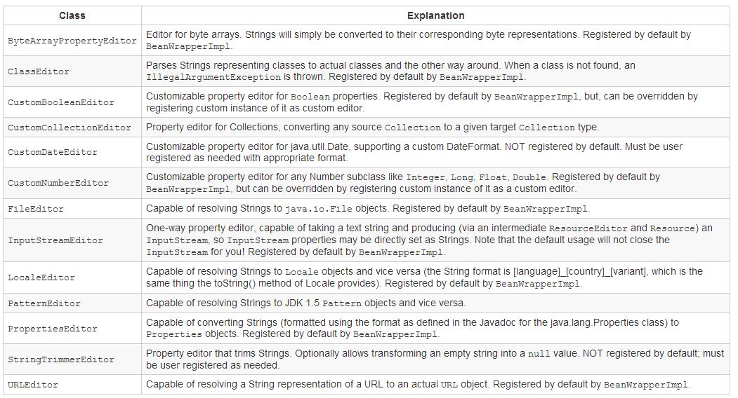
Bean definition configuration – PropertyEditors

Slide 57
Bean definition configuration – PropertyEditors
package com.epam.botor.domain;
import java.beans.PropertyEditorSupport;
public class LightSabreEditor extends PropertyEditorSupport {
@Override
public void setAsText(final String text) {
String[] textParts = text.split(",");
String name = textParts[0];
int damage = Integer.parseInt(textParts[1].trim());
LightSabre result = new LightSabre(name, damage);
setValue(result);
}
}
Notes:
6519e9033 PropertyEditor - JavaBean standard
ET: create a lightsabre editor
EA: extend the lightabre editor to support optional colour, and double bladed flag
Test if the lightsabres created with PropertyEditors/Converters are beans (e.g. with @PostConstruct)

Slide 58
Bean definition configuration – PropertyEditors
Register custom editors
JavaBeans standard (no Spring specific registration required) place in the same package as the class with name „[Classname]Editor”
Spring way
<bean class="org.springframework.beans.factory.config.CustomEditorConfigurer">
<property name="customEditors">
<map>
<entry key="com.epam.botor.domain.LightSabre" value="com.epam.botor.propertyeditors.LightSabreEditor"/>
</map>
</property>
</bean>
Notes:
6519e9033 PropertyEditor - JavaBean standard
1a464636a PropertyEditor – Spring
ET:
- Register 2 ways (old, Spring)
birthdate for jedi (custom registered)
Made in for lightsabre
EA:
enable StringTrimmerEditor
Add optional url to the Sith to his homepage

Slide 59
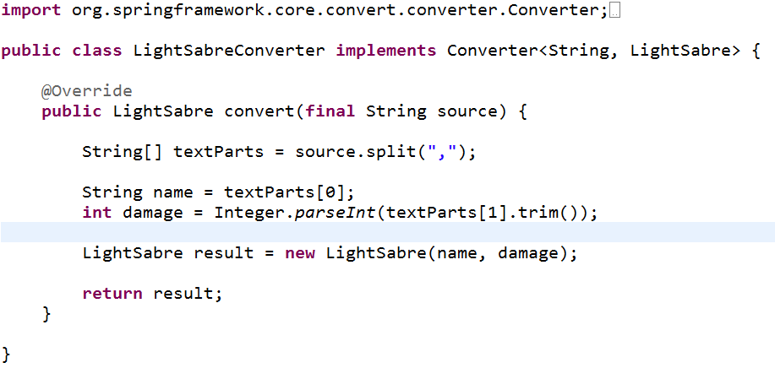
Bean definition configuration – Converter SPI
To replace PropertyEditors with a modern type safe solution
Notes:
ET: Spring converter for lightsabre
EA: Spring converter for a Trooper, man ships with troopers

Slide 60
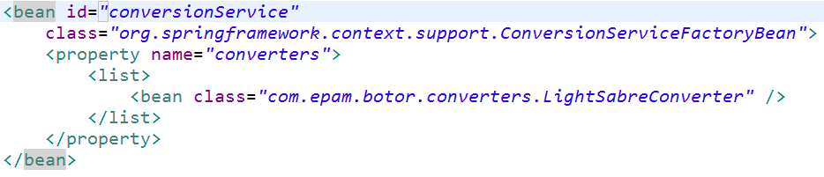
Bean definition configuration - Convert SPI
Register converters (note the id!)
Notes:
ET
aa6060862 PropertyEditor - Spring Converter
EA:
Formatter SPI

Slide 61
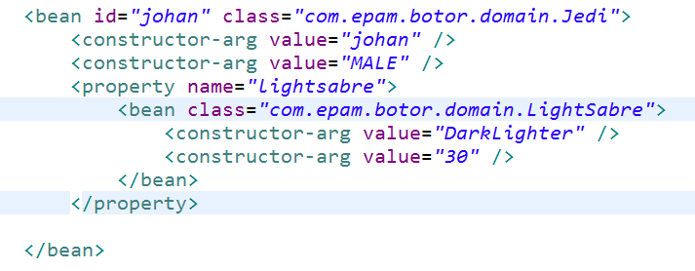
Bean definition configuration – Inner beans
anonymous, created only for the outer bean, not visible from elsewhere
id, name, scope attributes are ignored
Notes:
f6de7ae03 Configuration - Inner beans
ET: inner lightsabre for Jedi
EA: inner Trooper for the ships

Slide 62
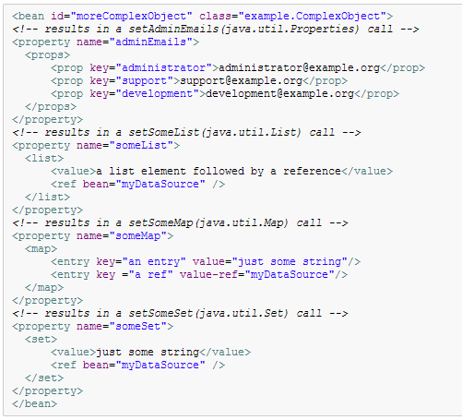
Bean definition configuration – Collections
Notes:
1324726f5 Bean config – collections
ET:
Sith with multiple lightsabres
Army with attackers, defenders (map)
ADD BATTLEPRINTER
EA:
- create weapons, shipweapons
- man/equip ships, use all the types

Slide 63
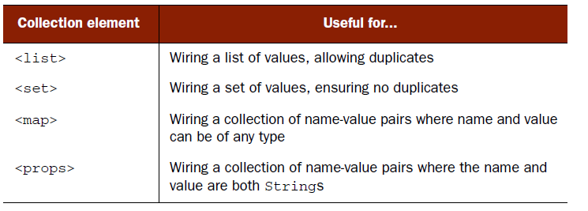
Bean definition configuration – Collections
list/set:
check duplicates at bean definition level (!) AND
inserts into an appropriate collection implementation (List/Set) based on the type of the property, NOT the tag!
Notes:
f1b58e301 Bean config - inharitance AND list/set difference
c0fc26c04 Bean config - list/set – EQUALS
009e78daa Bean config - list/set - EQUALS, PROPER CLASS
ET:
- Use prototype beans (Troopers)
Do not override equals
- place multiple into set (Army)
- place multiple into list (Army)
Override equals

Slide 64
Bean definition configuration – Collections
util:list, util:set, util:map, util:properties
Notes:
set-class/list-class property
ET: refactor some inner lists (attacker lists) for army
EA: do the same for ships

Slide 65
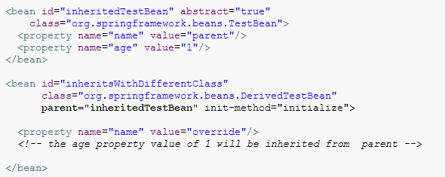
Bean definition configuration – Inheritance
child bean definition uses the bean class from the parent definition if none is specified
… but can also override it
always taken from the child definition: depends-on, autowire mode, dependency check, singleton, scope, lazy init.
abstract: it is usable only as a pure template bean definition
Notes:
f1b58e301 Bean config - inharitance AND list/set difference
Clarify the bean, class, bean definition difference again: abstract means abstract bean definition, NOT an abstract class!
But similiar at class definition level: cannot be instantiated
ET: abstract dark army with leader Bane
EA: abstract star destroyer, with default weapons, but without fighters

Slide 66
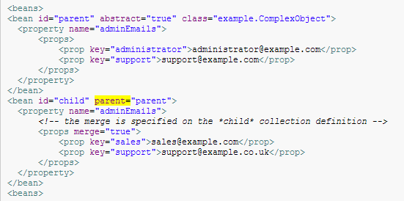

Bean definition configuration – Collections
Notes:
beans:default-merge

Slide 67
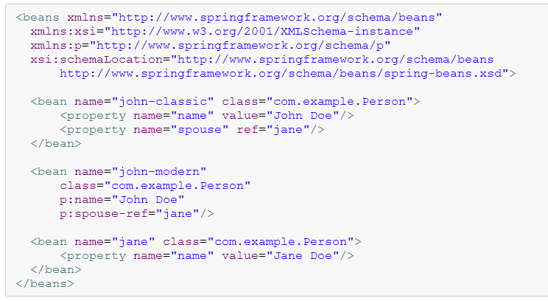
Bean definition configuration – p: namespace
Notes:
Bean config - c/p namespaces, util:list/set/map

Slide 68
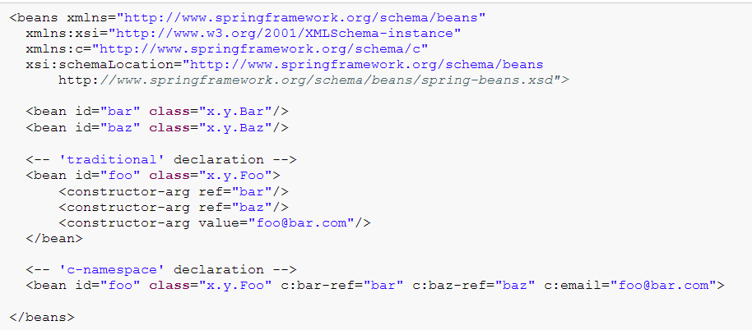

Bean definition configuration – c: namespace
Notes:
EA: use p and c everywhere

Slide 69
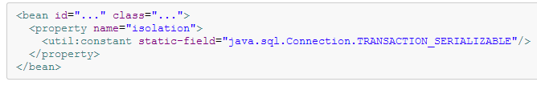
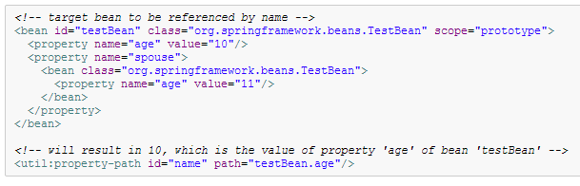
Bean definition configuration – util namespace
util:list, util:set, util:map, util:properties
util:constant
util:property-path
Notes:
Constant: ENUM, and any other public static final path
Property-path: any bean can be used, AND you can use a POJO as well, retrieved via constant
4a2f21291 Bean config - util:constant
44032056f Bean config - util:property-path
ET: use constants to extract default lordname from Sith type
use p. path to extract a complete Sith without lighsabre
EA: use constants to extract enum (FighterType) and use in the map as keys
use p. path to stole the lightsabre of the sithlord and give it to a darkjedi

Slide 70

Bean definition configuration – compound property names
neither „fred”, nor „bob” can be null of course
useful when overriding a parent definition (otherwise rarely used)
Notes:
ba942fe4c Bean config - compound properties
ET: replace the lord’s lightsabres with a fake set (through setting a compound property on an army)
EA: replace something on a ship ☺

Slide 71
Spring expression language (SpEL) - basics
http://docs.spring.io/spring/docs/3.2.6.RELEASE/spring-framework-reference/html/expressions.html
Do not confuse with other expression languages (in JSP, JSF, or the Unified EL)
Features
accessing properties (with optional safe navigation, default values, list filtering. etc.)
calling methods
calling constructors
operators, inline lists, arrays, etc.
leverages Converter SPI
(custom variables and methods)
Usage
standalone (rarely)
within Spring modules, e.g. in XML, annotations to define bean definitions

Slide 72
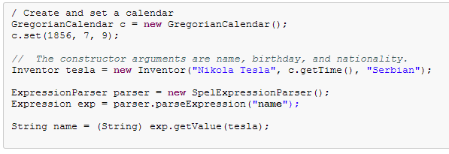
SpEL – standalone usage

Slide 73
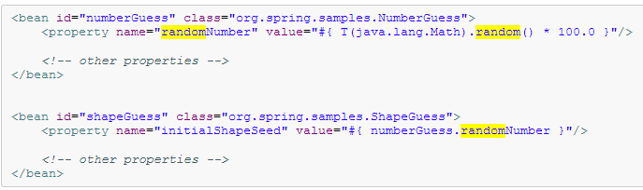
SpEL – bean definitions
SpEL expressions can be used with XML (or annotation based) configuration metadata for defining BeanDefinitions
#{ <expression string> }
Notes:
ET: give random damage to a prototye „commonBlaster”
EA: collect the ELITE (blaster damage > 20) dark fighters and put it in the darkFightersMap… 1 line!
cc880d550 Bean config – SpEL

Slide 74
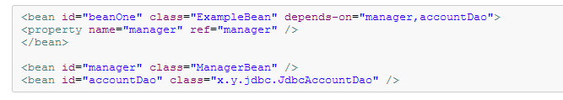
Bean definition configuration – depends-on
For dependencies which the Container cannot find out examining the property and constructor dependencies (accountDao will be created sooner even if there is no need to inject an instance)
e.g: a static initializer of class does something another need
use it only at last resort! Express your dependencies directly!
Notes:
1aa22b989 Bean config - depends-on
ET: play with army creation time

Slide 75


Bean definition configuration – lazy initialization
ApplicationContext eagerly creates and configures all singleton beans as part of the initialization process
Disable this eagerness with lazy-init: only if necessary
Notes:
ef84814d8 Bean config - lazy-init
ET: abandoned lightsabre

Slide 76
Aware interfaces
ApplicationContextAware: if you want to access the ApplicationContext
BeanNameAware: if you want to know your „name”
There are other „Aware”-s… in general: DO NOT use them (it is against DI concept)
Notes:
Beware! Do not use the applicationContext for getting beans… sometimes it can be useful, but it is a bad practice (DI!)
Use it for additional features like i18n, event handling, etc.
Autowire is better!
ef84814d8 Bean config - lazy-init
ET: use lazy it and BeanNameAware to show when it was created

Slide 77
Bean definition configuration – autowire
You can allow Spring to resolve collaborators (other beans) automatically for your bean by inspecting the contents of the ApplicationContext
„autowire” attribute of the <bean/> element: „whatByHow should be auto-wired”
no (default): should be „nothing”
byName: should be „propertiesByName”
byType: should be „propertiesByType”
constructor: should be „constructorArgsByType”
in case of ambiguities an error is thrown OR you can fine tune the resolution
„autowire-candidate” attribute of the <bean/> element
enable/disable a bean to be candidate
„primary” attribute of the <bean/> element
designate a bean as the primary candidate
annotations offer better options as well (see there)
Notes:
Explicit wiring always overrides autowire
Show defaults in bean(s!)
Note there is no such option to auto-wire both consuctors and properties (annotations will save the day)
bc2d569d2 Bean config - auto-wire: byname
ET: autowire conversion service
dd9cf1dea Bean config - auto-wire: byType
ET: autowire a concrete lightsabre (use primary, after autowire-candidate)
d9c8b56c4 Bean config - auto-wire: constructor
ET: autowire a concrete jedi as the leader of the army
EA:
Create a BattleReporter interface, a concrate console implementation (refactor from Battle)

Slide 78
Bean definition configuration – autowire collections
In case of „byType” or „constructor” mode
to satisfy a typed collection dependency (e.g List<LightSabre>), the container will collect all the beans in the context with the required type (LightSabre) and inject ALL of them (now as a List)
to satisfy a Map<String, X> dependency the container will collect all the beans in the context with type X and inject a Map where values be the found beans and the keys will contain the corresponding bean names
In case of „byName” mode
you can auto-wire collections defined as <utils:list>, <utils:map>, or <utils:set>
Notes:
349bdbcc2 Bean config - auto-wire: collections
EA: let the lord collect all the lightsabres (but not the jedi’s: if it possible use autowire-candidate to disable): byType

Slide 79
Bean definition configuration – autowire pros
significantly reduce the need to specify properties or constructor arguments
speed up development: a new dependency can be satisfied automatically, without wiring explicitly

Slide 80
Bean definition configuration – autowire cons
less exact than explicit wiring
you cannot autowire: primitives, Strings, and Classes (and arrays of such simple properties)
wiring information may not be available to tools that may generate documentation from a Spring container
multiple bean definitions within the container may match the type
abandon auto-wiring
use specifiers (primary, autowire-candidate)
use annotations

Slide 81
Bean definition configuration – method injection
Discussed in AOP Training

Slide 82
BeanFactoryPostProcessor
Manipulates bean configuration
Executed „at appropriate time” (after the container has loaded the configuration but has not instantiated any beans yet)
Typically you won’t write your own, but use the available BeanFactoryPostProcessors
CustomEditorConfigurer (you have seen)
PropertyPlaceholderConfigurer (you will see)
PropertyOverrideConfigurer (homework!)
etc.

Slide 83
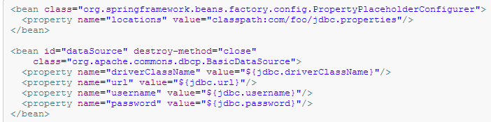

PropertyPlaceholderConfigurer
With namespace:
Notes:
Do not forget file encoding
2a9f0464a PropertyPlaceholderConfigurer
ET: externalize lightsabre damage
EA: externalize all the names of Jedi

Slide 84
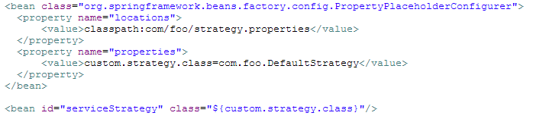
PropertyPlaceholderConfigurer
System properties (-D [XXX]) and OS variables used as fallback (configurable)
You can define properties directly in the XML
Notes:
Also looks for properties in the System properties as fallback (can be configured)
It is not entirely true (see unified property handling)
ET: override lightsabre damage using OS variable
EA: override lord name using -D

Slide 85
Configuration externalization options
Goal
different config for different environments (QA/PROD)
same artifact for each environment
keep your credentials safe
help the DevOps team
no recompile/rebuild
limited or no config file editing
Toolset
Maven (profiles + resource filtering)
Spring (Profiles + PropertyPlaceholderConfigurer)
property files (embedded in or out of artifact)
Java system properties (-D)
OS environment variables
Notes:
Solutions: think about it together!
Solution:
Do NOT use resource filtering in Maven, be careful with Maven profiles
Create the same artifact
Use only OS variables OR external property files (specify path via OS variable) OR pack ALL the config files in the artifact and specify the „mode” (DEB/QA/PROD) via OS variable (not configurable by DevOps this way)
Use Spring profile if it is a must (specify active profile via OS variable (through -D))
Define passwords in OS variable at load time and delete it after

Slide 86
FactoryBean
If you have complex initialization code that is better expressed in Java
Object getObject(): returns an instance of the object this factory creates.
boolean isSingleton(): returns true if this FactoryBean returns singletons
Class getObjectType(): returns the object type returned by the getObject()
If you ask for a „commonBlaster” from the container it will return a „Blaster”
instance, not a BlasterFactoryBean!
use getBean(„&commonBlaster”) to get a BlasterFactoryBean (rarely used)
<bean id="commonBlaster" class="com.epam.botor.domain.BlasterFactoryBean"
scope="singleton" c:damageRange="30" />
Notes:
30cb2d5b4 FactoryBean
ET: BlasterFactoryBean: random creation of rifle or pistol
EA: configurable probability from property file, optional (setter)

Slide 87

<util:constant> as FactoryBean
Simplified usage (how can it use its own ID?):
Notes:
EA: BeanNameAware

Slide 88
Factories in Spring
prototype scope
actually it is a primitive factory in its own (think about it!)
FactoryBean
preferred Spring style factory, if the instantiation logic is complex
factory-bean + factory-method
old style factory (Factory Method/Abstract Factory pattern), use typically working with legacy code
factory-method
old style static style factories (Static Factory/Simple Factory pattern), use typically working with legacy code (also to deal with legacy singletons)
lookup methods, ServiceLocatorFactoryBean (in AOP training)
Notes:
http://corey.quickshiftconsulting.com/1/post/2009/5/first-post.html
http://stackoverflow.com/questions/4209791/design-patterns-abstract-factory-vs-factory-method
http://architects.dzone.com/articles/factory-method-vs-abstract
Using org.springframework.beans.factory.config.ServiceLocatorFactoryBean: http://kh-yiu.blogspot.be/2013/04/spring-implementing-factory-pattern.html
„I also believe that we should not be obsessed with design patterns, these are all built on good basic design principles, and often mixed while using in real world.”
EA: implement the BlasterFactory with the other 2 approaches

Slide 89
Annotation based bean configuration
Relies on byte code level metadata (i.e.: Annotations ☺) instead of XML
XML configuration always overrides Annotations
<context:annotation-config/>
AutowiredAnnotationBeanPostProcessor
CommonAnnotationBeanPostProcessor
PersistenceAnnotationBeanPostProcessor
RequiredAnnotationBeanPostProcessor
Notes:
No!

Slide 90
Annotation based bean configuration
@Required
on setter methods to make them required dependency (checked by the container at load time)
@Autowired: like auto-wire in XML (byType AND byName as fallback)
@Qualifier: offers finer grade control than „primary”
if the @Autowire fails because of multiple candidates, then @Qualifier can filter them (candidates are also marked)
<qualifier> in XML to mark candidates
auto-wire in XML ignores <qualifier>
Notes:
At this point we do not know that @Qualifier can be used on classes
d1a074a46 @Required
ET: make the lightsabre required (but if it is required then why not a constructor ;) )
5ca369d8a @Autowired & @Qualifier
ET: refactor replace everything with @Autowired which is possible (blaster for trooper, battleground and armyies for Battle, leader for army), add <qualifiers>: defaultSithLightsabre, defaultJediLightsabre, Leader
EA: refactor ships similarly

Slide 91
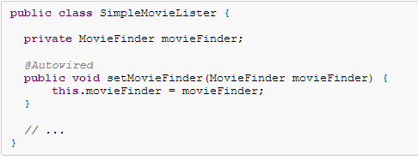

Annotation based bean configuration
@Autowired on setters
@Autowired on any methods with arguments

Slide 92
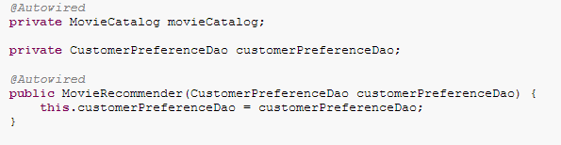
Annotation based bean configuration
@Autowired on constructors/fields
Notes:
Even private fields!

Slide 93
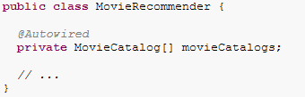
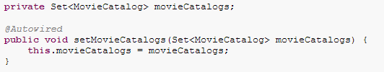
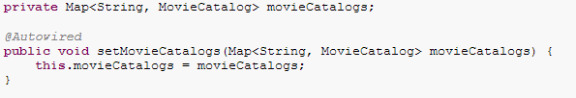
Annotation based bean configuration
@Autowired for collections
Notes:
Like in XML

Slide 94

Annotation based bean configuration
@Autowired for well-known dependencies
BeanFactory, ApplicationContext, Environment, ResourceLoader, ApplicationEventPublisher, and MessageSource

Slide 95
Annotation based bean configuration
@Autowired behaviour
„byType”/”constructor”, if fails: „byName”
NEVER use it if you really want to wire by name! (use @Resource instead)
required attribute: means „it is required to be autowired” (weaker than @Required)
can not be used within a BeanPostProcessor or BeanFactoryPostProcessor. Why?
Notes:
ET:
@Autowired, @Inject, @Resource, and @Value annotations are handled by a Spring BeanPostProcessor implementations which in turn means that you cannot apply these annotations within your own BeanPostProcessor or BeanFactoryPostProcessor types (if any). These types must be 'wired up' explicitly via XML or using a Spring @Bean method.
Actually byName is the default Qualifier it uses

Slide 96
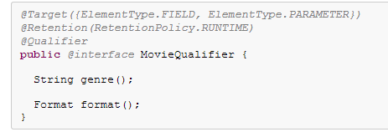
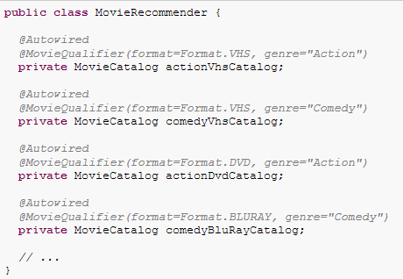
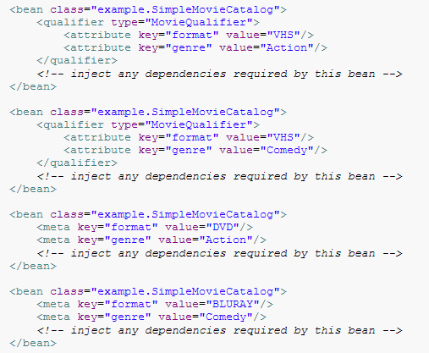

Annotation based bean configuration
Custom qualifiers
Notes:
meta is a fallback
EA:
Create an annotation for fighters (@FighterType, type= HEAVY, LIGHT)
Define 10 fighters, use meta/qualifier and let @Autowire collect (e.g. 2 properties of a star destroyer)

Slide 97
JSR-250
Part of Java SE 6 (the non Java EE related ones)
@Resource(s)
auto wiring „byName”
only on fields and setters with a single argument
@PostConstruct
@PreDestroy
Notes:
If you intend to express annotation-driven injection by name, do not primarily use @Autowired, even if is technically capable of referring to a bean name through @Qualifier values. Instead, use the JSR-250 @Resource annotation, which is semantically defined to identify a specific target component by its unique name, with the declared type being irrelevant for the matching process.
As a specific consequence of this semantic difference, beans that are themselves defined as a collection or map type cannot be injected through @Autowired, because type matching is not properly applicable to them. Use @Resource for such beans, referring to the specific collection or map bean by unique name.
@Autowired applies to fields, constructors, and multi-argument methods, allowing for narrowing through qualifier annotations at the parameter level. By contrast, @Resource is supported only for fields and bean property setter methods with a single argument. As a consequence, stick with qualifiers if your injection target is a constructor or a multi-argument method.
7f64791f7 @Resource
ET: use @Resource when it is logical instead of @Autowire and @Qualifier

Slide 98
Annotation based bean definition
Bean definition registration
scanning
stereotypes (roles): @Component, @Service, @Controller, @Repository, etc.
Bean definition metadata
@Scope
@Qualifier
@Value
(@Bean, @Lazy, possible here as well but use them ONLY in JavaConfig (@Configuration), just forget it now )

Slide 99
Annotation based bean definition
Bean definition registration
<context:component-scan base-package="com.epam.botor.domain" />
it implicitly enables <context:annotation-config>
you can define more sophisticated filters
resource-filter attribute
include/exclude filters in the body of the element
default (can be disabled)
@Component
and all the other stereotypes: @Repository, @Service, @Controller
Notes:
You can disable auto-annotation config through an attribute
Custom bean naming with @Component
0e962398c @Component
EA: make everything component (which you can)

Slide 100
Annotation based bean definition
Bean definition metadata
@Scope
counterpart of „scope” attribute of <bean>
@Qualifier
together with @Autowired
acts as a filter in case of multiple candidates (see several slides before)
without @Autowired
acts as <qualifier> in XML
@Value
counterpart of „value” attribute in XML
accepts SpEL (just like „value”)

Slide 101
Annotation based bean definition
Keep in mind!
Annotation metadata (@Scope, @Qualifier, @Component(„name”)) is bound to the class definition itself…
…while the use of XML allows for multiple beans of the same type because that metadata is provided per-bean definition rather than per-class.
So it is NOT possible (out of the box) to create two beans with the same class but different names using annotations
Notes:
(more precisely: using non-JavaConfig annotations, we’ll see it later)
é

Slide 102
JSR-330 (Dependency Injection for Java)
@Inject replacing @Autowired
@Named replacing @Component/@Qualifier
Standard! Sounds good, rarely anybody uses…
somewhat limited capabilities
sometimes work slightly differently
use only if you project demands (is it likely that you change you DI framework?)

Slide 103
JavaConfig: Java-based configuration
Goal: absolutely XML-less bean definition
type safe, String-less definition
non-invasive
„natural” for hardcore Java developers
„weirdo” for all the others ☺
Notes:
638bd3c6c @Configuration – 1
…
5ca0efac9 @Configuration – 10

Slide 104
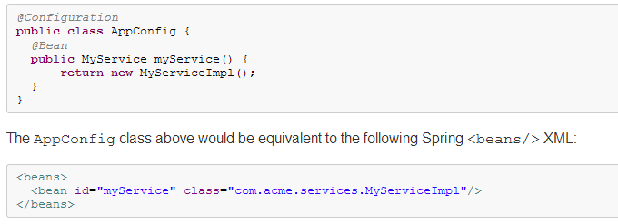
JavaConfig: Java-based configuration
@Configuration
replacement for an XML file
@Component (hence recognized by scanning)
indicates that the class is for configuration

Slide 105
JavaConfig: Java-based configuration
@Bean (using @Scope, @DependsOn, @Lazy)
replacement for <bean>
methods only
indicates that a method produces a bean to be managed by the Spring container (= <bean>)
use only in @Configuration to avoid strange bugs!
everything work as if bean definition was created in XML (XML element attributes → annotation attributes)
lifecycle callbacks
aware interfaces
naming
Notes:
BeanDefiniton is equivalent!
You can mix and match as you want! (be consistent!)

Slide 106
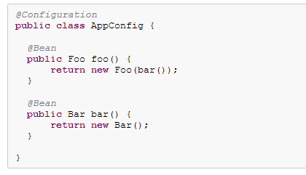
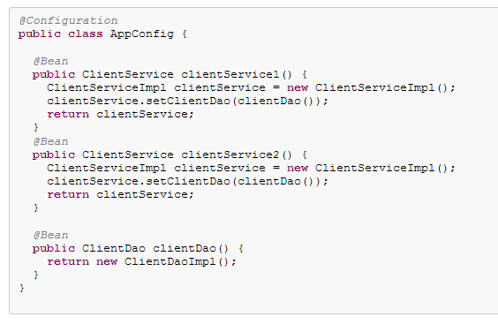
JavaConfig: Java-based configuration
Injecting dependencies (setter/constructor)
Notes:
BeanDefiniton is equivalent!
You can mix and match as you want! (be consistent!)

Slide 107
JavaConfig: Java-based configuration
How is „clientDao” a singleton? (because it is!)
A bit of „magic” (until the Spring AOP training): CGLIB
All @Configuration classes are sub-classed at startup-time with CGLIB (3rd party code generation framework embedded in Spring)
In the subclass, the overridden method checks the container first for any cached (scoped) beans before it calls the parent method and creates a new instance

Slide 108
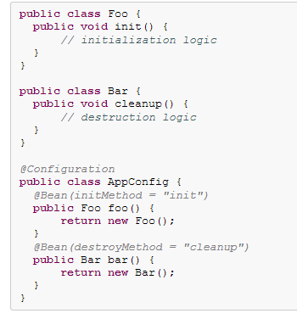
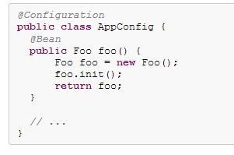
JavaConfig: Java-based configuration
Lifecycle callbacks
When you work directly in Java(Config), you can do anything you like with your objects and do not always need to rely on the container lifecycle!
Notes:
BeanDefiniton is equivalent!
You can mix and match as you want! (be consistent!)

Slide 109

JavaConfig: Java-based configuration
AnnotationConfigApplicationContext
reads @Configuration bean definitions instead XML
The same effect but the „cool” way: component scan detects all @Configuration (since they are @Component)
Notes:
ET

Slide 110
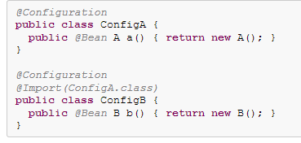
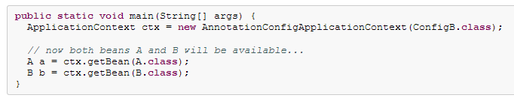
JavaConfig: Java-based configuration
@Import replacement for <import>
This approach simplifies container instantiation, as only one class needs to be dealt with
Notes:
ET

Slide 111
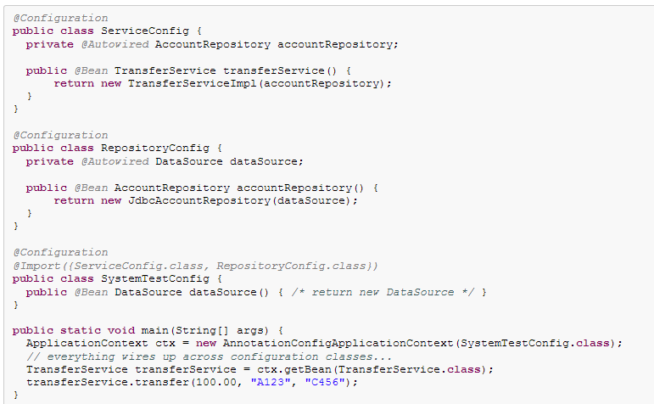
JavaConfig: Java-based configuration
Injecting dependencies on imported @Bean definitions
Notes:
ET

Slide 112
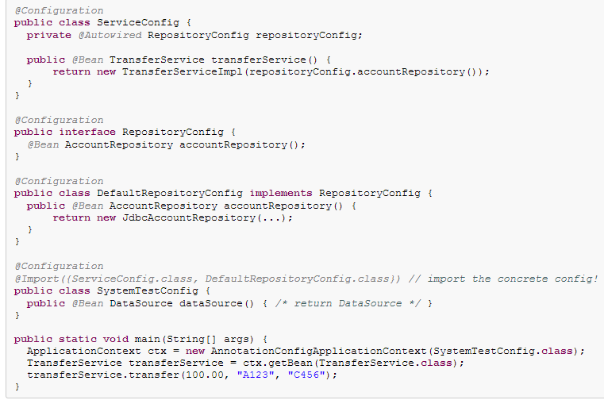
JavaConfig: Java-based configuration
Injecting dependencies on imported @Bean definitions – fully qualified

Slide 113



JavaConfig: Java-based configuration
Bootstrap: @Configuration classes as plain Spring <bean/> elements

Slide 114

JavaConfig: Java-based configuration
Bootstrap: <context:component-scan/> to pick up @Configuration classes

Slide 115



JavaConfig: Java-based configuration
Bootstrap: @Configuration only
Notes:
ET
Let’s refactor!
in every step the code will work!
http://forum.spring.io/forum/spring-projects/container/45694-accessing-parent-beans-in-javaconfig
You can replace all XML (even the propertyplaceholder)

Slide 116
JavaConfig: Java-based configuration
@ComponentScan: replacement for <context: component-scan>
@ImportResource: to import an XML configuration in a @Configuration class
@PropertySource: source definition for a PropertySourcesPlaceholderConfigurer
Notes:
http://spring.io/blog/2011/02/15/spring-3-1-m1-unified-property-management/

Slide 117
Unified property management (Spring 3.1)
PropertySource class
property (key-value pairs) source definition
registered by default
PropertySource for System.getProperties()
PropertySource for System.getenv()
you can add your own (programmatically or via @PropertySource)
<context:property-placeholder location=„XXX”/> no longer registers a PropertyPlaceholderConfigurer but rather a PropertySourcesPlaceholderConfigurer, which creates a PropertySource for the „location” and falls backs to other PropertySources (using Environment)
Environment
get properties directly (PropertySource hierarchy) (prefer PropertySourcesPlaceholderConfigurer in your code)
determine which profiles are active (see later)
can be autowired
Notes:
http://spring.io/blog/2011/02/15/spring-3-1-m1-unified-property-management/
Old way: there were fallback only to System.getProperties() and System.getenv()

Slide 118


Unified property management (Spring 3.1)
Notes:
http://spring.io/blog/2011/02/15/spring-3-1-m1-unified-property-management/
Old way: there were fallback only to System.getProperties() and System.getenv()
STATIC!
@Bean JavaDoc
BeanFactoryPostProcessor-returning @Bean methods
Special consideration must be taken for @Bean methods that return Spring BeanFactoryPostProcessor (BFPP) types. Because BFPP objects must be instantiated very early in the container lifecycle, they can interfere with processing of annotations such as @Autowired, @Value, and @PostConstruct within @Configuration classes. To avoid these lifecycle issues, mark BFPP-returning @Bean methods as static. For example:
@Bean public static PropertyPlaceholderConfigurer ppc() { // instantiate, configure and return ppc ... }
By marking this method as static, it can be invoked without causing instantiation of its declaring @Configuration class, thus avoiding the above-mentioned lifecycle conflicts. Note however that static @Bean methods will not be enhanced for scoping and AOP semantics as mentioned above. This works out in BFPP cases, as they are not typically referenced by other @Bean methods. As a reminder, a WARN-level log message will be issued for any non-static @Bean methods having a return type assignable to BeanFactoryPostProcessor.

Slide 119
JavaConfig: Java-based configuration
@Bean vs. @Component summary
@Bean (in a @Configuration class) – JavaConfig feature!
gives you the same features as the XML <bean> in Java
centralizes the configuration (just like an XML file does)
@Component – Annotation config feature!
automated bean definitions recognized by component scanning
decentralized
it is a bit confusing because they are both annotations ☺
NOT every annotations fall to category „Annotation config”
you can mix JavaConfig and Annotation Config (think of using setter @Autowired in a bean created by @Bean) just as you can mix XML and Annotation Config… CONSISTENCY!
You can even configure your JavaConfig with „Annotation config” (think of @Autowired within @Configuration classes)
@Configuration itself is actually: declaring JavaConfig using Annotation config (think of @Configuration is @Component)

Slide 120
JavaConfig: Java-based configuration
Important nuances
Difference between an autowired member variable and an autowired @Bean method parameter
injected once vs. as many times as we call the method
pass „null„ for that latter (in another @Bean) and it will be autowired
The is NO „constructor” autowiring for beans returned by @Bean methods (since you call „new” in @Beans)
Order in @Import order does not matter

Slide 121
i18n
I[nternationalizatio]n: Locale based message resolution
Always set your encoding properly (UTF-8) for read and write as well!
language (message) files (effectively property files)
Java code
property files
XML
Java SE
ResourceBundle
MessageFormat
Spring
MessageSource (uses ResourceBundle and MessageFormat)
Notes:
http://docs.oracle.com/javase/tutorial/i18n/
ET: read through API together

Slide 122






I18n – java.util.ResourceBundle
Notes:
In theory it can also use classes to store key-value pairs, but in practice it is rarely used
http://docs.oracle.com/javase/7/docs/api/java/util/ResourceBundle.html

Slide 123

I18n – java.text.MessageFormat
Notes:
http://docs.oracle.com/javase/7/docs/api/java/text/MessageFormat.html

Slide 124


I18n – Spring MessageSource
ApplicationContext implements MessageSource
At load time it is searches for a bean named „messageSource” and delegates to this bean
You can autowire a MessageSource using @Autowired, or use MessageSourceAware (effectively it will be your ApplicationContext of course)
Notes:
format.properties, exceptions.properties, windows.properties, _en_GB, _en_US

Slide 125
I18n – Spring MessageSource
The basic method used to retrieve a message from the MessageSource. When no message is found for the specified locale, the default message is used.
Any arguments passed in become replacement values, using the MessageFormat functionality provided by the standard library.
Notes:
format.properties, exceptions.properties, windows.properties
ET: it18n battlecries
EA: add other translations, there is a reloadable version, try it
cbcde616c i18n
a1ee4ab2a i18n - with configuration file (inject Locale via a @Value({locale.default}))
f3bf1f91f i18n – parameters (add the name to a battlecry)

Slide 126

Basic event handling
If a bean that implements the ApplicationListener interface is deployed into the context, every time an ApplicationEvent gets published to the ApplicationContext, that bean is notified (Observer pattern)
Standard events

Slide 127
Basic event handling
create custom events extending ApplicationEvent
publish using an ApplicationEventPublisher (autowire or *Aware)
Listen to it implementing ApplicationListener
synchronous, single threaded event delivery!
Notes:
EA:
publish an event when a fighter randomly explodes after a fight, and let a listener print it

Slide 128
Spring container hierarchy
ClassPathXmlApplicationContext applicationContextParent = new ClassPathXmlApplicationContext("parentConfig.xml");
ClassPathXmlApplicationContext applicationContext = new ClassPathXmlApplicationContext(new String[]{"config.xml"}, applicationContextParent);
You can create context hierarchies
if a required bean is not found in the given context, then its parent is queried
can be useful for modular apps where modules can live their own lives
Notes:
e.g. in Spring MVC

Slide 129

Spring profiles
Conditional bean definition
Notice the embedded <beans> element
@Profile (on @Configuration class)

Slide 130

Spring profiles
Activation

Slide 131
Spring profiles
Do NOT use where PropertyPlaceholderConfigurer can get the job done
The set of beans registered between two profiles should probably be more similar than different
Do you really want to test with very different settings in QA?
Notes:
http://spring.io/blog/2011/02/11/spring-framework-3-1-m1-released/
ET: disable some fighters based on a spring profile

Slide 132
Other spring framework features
AOP: another training
Spring MVC, REST services: another training
Validation, Data Binding, Conversion: covered by this and other trainings
Data Access (JDBC, ORMs): pretty straightforward after learning about JDBC/JPA
http://docs.spring.io/spring/docs/3.2.6.RELEASE/spring-framework-reference/html/spring-data-tier.html
Test support (unit, integration)
O/X support
„Enterprise” services
Remoting (RMI, JAX-RPC, JAX-WS)
JMS
REST client
JMX
Email
Scheduling
Cache, etc.

Slide 133
Other spring projects
http://spring.io/projects
Notes:
ET read though together

Slide 134
Books and other useful references
Spring in Action
most well-known
touches many things but far from being exhaustive
http://www.amazon.com/Spring-Action-Craig-Walls/dp/1935182358/ref=sr_1_3?ie=UTF8&qid=1391418399&sr=8-3&keywords=spring
Spring in Practice
a more practical approach (read it only after Spring in Action)
http://www.amazon.com/Spring-Practice-Willie-Wheeler/dp/1935182056/ref=sr_1_1?ie=UTF8&qid=1391418399&sr=8-1&keywords=spring
Spring Reference
you’ll end up here eventually… ☺
http://docs.spring.io/spring/docs/3.2.6.RELEASE/spring-framework-reference/html/
JavaDoc of main annotations, classes ☹ (DO NOT FORGET!)

Slide 135
Homework –definite
Create a command line application

Slide 136
Homework – creative
Take your favorite fantasy world and create a similar application, telling a story in that world
use as many concept you learned during the training as you reasonably can
try to use patterns/solutions as you would use in a real application
(our current one may contain improper ones for the sake of the presentation)
use XML/Annotation/Java config as you prefer
Share the result with me using git
Have fun, and surprise me with the result ☺

